Slide 1
Assessment practices in the Post-communicative ERA: A multiliteracies perspective
Heather Willis Allen – University of Wisconsin - Madison
Beatrice Dupuy – University of Arizona
Kate Paesani – Wayne State University

Slide 2
Overview
Background
Multiliteracies framework
Assessment in a multiliteracies framework
Sample multiliteracies assessments

Slide 3
Background

Slide 4
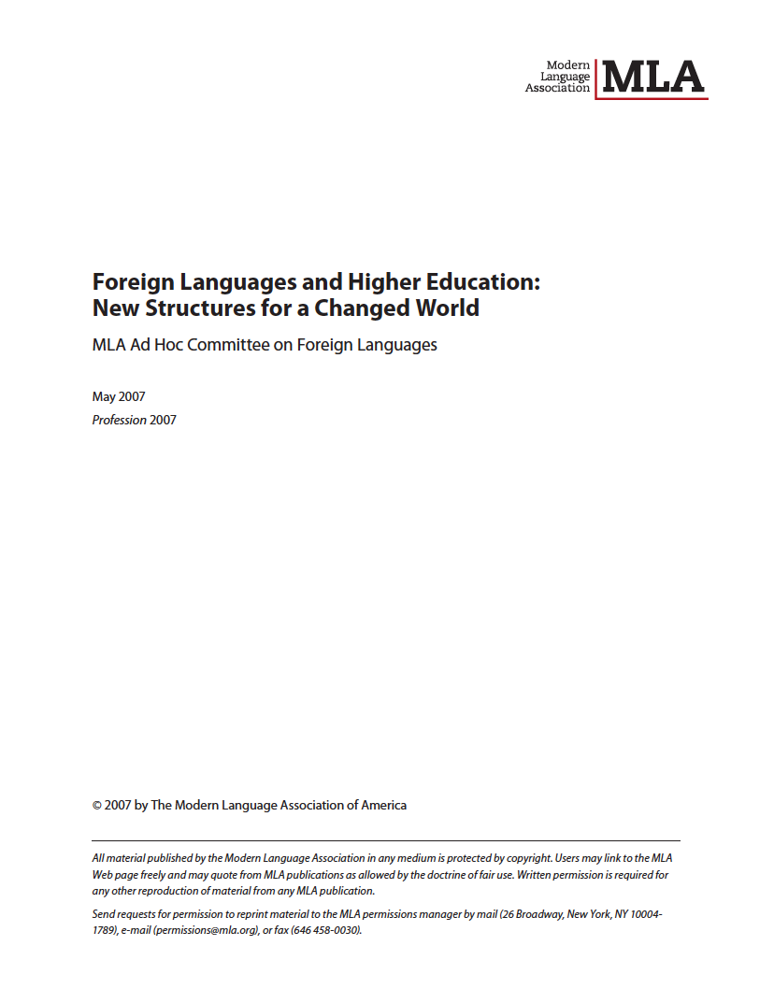
2007 MLA Report
A call for change
Notes:
In 2007, the MLA Report called for a major reform of the foreign language undergraduate curriculum in 2 primary areas: curricular content and departmental governance, today our focus will be on the first one and what it means for assessment.

Slide 5
2007 MLA Report: A call for change
Notes:
THIS CALL FOR CHANGE IS NOT NOVEL, IN FACT, SIMILAR RECOMMENDATIONS HAVE BEEN MADE OVER THE PAST 15-20 YEARS.
TRANSITION: a number of implications fall out from this call for curricular change…

Slide 6
Responding to this call for change: Implications for instruction and assessment
  Importance of context
  Centrality of L2 narratives across the curriculum
  Integration of modalities
  Integration of language and literary-cultural content
  Use of language as a tool for creative and critical thought
Notes:
CLT
although context and use of language as a tool for creative thought play a role in that language forms are presented within a meaningful context such as a dialogue or short descriptive text and that learners are asked to communicate orally and in writing, learners do not see language in various contexts that illustrate different kinds of discourse nor are they often asked to analyze language as used in authentic textual contexts
narratives do not play a central role
modalities often viewed separately (reading, speaking, listening, writing)
focus more on linguistic content and functional language use, informational texts, expressing personal opinions than on the kind of content found in cultural narratives, literature, etc.
TRANSITION: we propose that the concept of literacy and the multiliteracies framework respond more fully to these calls for change and the implications arising from them

Slide 7
Multiliteracies Framework

Slide 8
What is literacy?
[T]he use of socially-, historically-, and culturally-situated practices of creating and interpreting meaning through texts. It entails at least a tacit awareness of the relationships between textual conventions and their contexts of use and, ideally, the ability to reflect critically on those relationships . . . literacy is dynamic – not static – and variable across and within discourse communities and cultures. It draws on a wide range of cognitive abilities, on knowledge of written and spoken language, on knowledge of genres, and on cultural knowledge.
(Kern, 2000, p. 16)
Notes:
Very different from the commonplace notion of literacy or being literate versus illiterate -> being able to operate between languages and cultures
This can be seen as the goal of instruction across the undergraduate language curriculum
Transition: In terms of what this means for the focus of language instruction … Kern also elaborated 7 principles of literacy

Slide 9
Seven principles of literacy
(Kern, 2000)
Interpretation
Writers and readers engage
in a double act of interpretation.
Collaboration
Audience impacts what writers decide to say or not say,
readers bring motivation and experience to make writers’ texts meaningful.
Conventions
The way we write and read texts is not universal, cultural conventions play a huge role in how we carry out both activities.
Cultural knowledge
Writing and reading function with specific cultural systems. For those operating outside a given cultural system, misunderstanding and being misunderstood by those operating within the given system is highly likely.
Problem-solving
Writing and reading involve figuring out relationships between word, between larger units of meaning, between texts and worlds.
Language use
Literacy is more than knowledge of writing systems, vocabulary and grammar. It requires knowing how to use language both in written and spoken contexts to create discourse.
Reflection and Self-reflection
Writers and readers think about language and its relation to the world and themselves.
Notes:
Whereas language use, conventions, and cultural knowledge represent core elements of literacy-based instruction, they are taught in conjunction with the processes of interpretation, collaboration, problem solving, and reflection. According to Kern, “this seven-point linkage between literacy and communication has important implications for language teaching, as it provides a bridge to span the gap that so often separates introductory ‘communicative’ language teaching and advanced ‘literary’ teaching” (p. 17).
One final concept related to

Slide 10
Key elements of multiliteracies-based teaching: Available designs
LINGUISTIC SCHEMATIC
writing system formal schemata
vocabulary genre / style
syntax content schemata
cohesion / coherence stories
(Kern, 2000)
Notes:
A key element of literacy-based pedagogy is design of meaning. Design is an active, dynamic process that involves he creation of form-meaning connections through interpretation or creation of texts. So this conception expands the typical focus in L2 instruction from a near exclusive focus on the linguistic available designs of grammar and vocabulary to include both other types of linguistic Available Designs as well as schematic Available Designs.
TRANSITION: So how does a literacy-based approach instantiate these ideas in instructional and assessment practices?

Slide 11
Assessment in a Multiliteracies framework

Slide 12
Literacy-based assessment
“What is evaluated constitutes the de facto curriculum, and how it is evaluated reflects the de facto philosophy of learning and teaching, regardless of what the teacher or course description says. Thus reading tests that only measure recall of factual content in effect define reading as a factual recall task. Grading essays on the basis of the number of grammar errors sends the message that producing error-free sentences is what foreign language writing is all about.”
(Kern, 2000, p. 267).
Notes:
What we can take from Kern’s quote is that alignment between instruction and assessment is essential, and that what and how you test learner progress has a backwash effect on instruction. If we consider CLT, the focus of testing is on linguistic knowledge but it tends to be decontextualized, or when a text is used, the focus is on discrete elements of that text. In a multiliteracies framework, because of the centrality of texts, the focus of assessment can be on the link between linguistic functions and meaning.

Slide 13
A literacy-based approach assesses learners’…
knowledge of syntax and vocabulary to fulfill particular communicative functions within the larger context of creating and interpreting meaning
analyses of texts and contexts and the new understandings generated by those analyses
ability to reflect on relationships
  form and function
  language and culture
Focus is on evaluating learners’ ability to use language as a tool of creative and critical thought

Slide 14
Literacy-based assessment: 4 characteristics
Linking linguistic form and meaning
Drawing on students’ knowledge of language, culture, and conventions
Integrating rather than separating communicative modalities; examining multiple perspectives of student performance
Being consistent with and contributing to teaching practices

Slide 15
Challenges
Focusing on available designs from multiple perspectives in various assessment types
Identifying appropriate means of assessing students’ understanding of cultural conventions and knowledge
Horizontal and vertical articulation of assessment
Students’ own motivations and L2 learning histories
Instructor buy-in to align teaching and assessment practices
Notes:
#1. looking at specific available designs and how they function in context as well as how to use available designs to express meaning creatively
#2. particularly challenging in the context of an exam where it’s difficult to contextualize cultural knowledge and determine what aspects of cultural knowledge should be tested; moreover, how do we integrate assessment of cultural knowledge with linguistic knowledge; what language do we use to assess cultural learning; etc.

Slide 16
Questions? Comments?
hwallen@wisc.edu
bdupuy@email.arizona.edu
k.paesani@wayne.edu
Related forthcoming publication in Fall 2013:
Paesani, K., Allen, H. W., Dupuy, B. A multiliteracies framework for collegiate foreign language teaching. Pearson, Prentice Hall Second Language Library Series.

Slide 17
Thank you

