Slide 1
Project PErCOLATE:
Preparing FL TAs for multiliteracies-oriented instruction
Beatrice Dupuy
University of Arizona
Heather Willis Allen
University of Wisconsin – Madison

Slide 2
Overview
2007 MLA Report: Call for change
Brainstorming activity
Long-standing collegiate FL TA training paradigm
A new model for FL TA professional development
Project PErCOLATE (Professional dEvelopment foR College fOreign LAnguage TEachers)
Questions and comments
Notes:
In this presentation, we will start off with a recap on the recommendations made by the MLA report, which gave the impetus for this project. Next, we will engage you in a brainstorming activity about graduate students’ development as teachers and reflect on the long standing collegiate FL TA paradigm, examining where it makes the mark and fall short. We will consider what new forms FL TA development in order to meet the MLA Report call for change and introduce project PErCOLATE. We will leave some time for questions at the end.

Slide 3
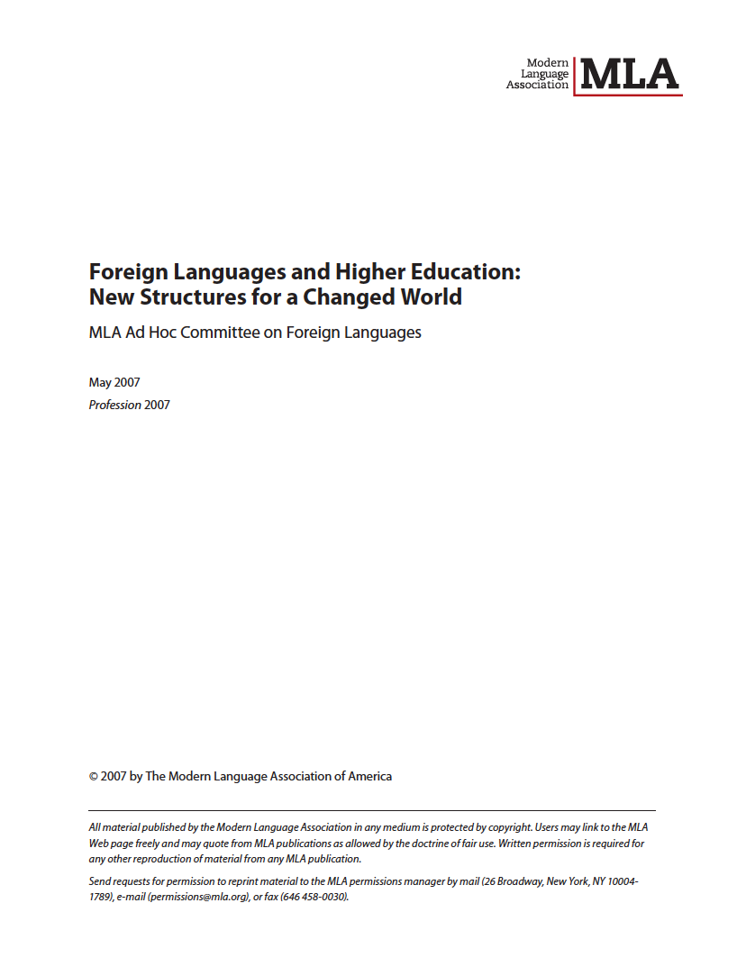
2007 MLA Report
A call for change
Notes:
In 2007, the MLA Report called for a major reform of the foreign language undergraduate curriculum in 2 primary areas: curricular content and departmental governance

Slide 4
2007 MLA Report: A call for change
Notes:
Key elements of recommendation 1 include: the development of students’ translingual and transcultural competence; and increased emphasis on target language texts at all levels of the curriculum
Recommendation 2 refers to the bifurcated nature of the FL undergraduate curriculum and highlights the need to narrow the gap that exists in the pedagogies used by those who teach lower-division and advanced undergraduate FL courses and increase and improve communication between the two teaching cohorts
THIS CALL FOR CHANGE IS NOT NOVEL, IN FACT, SIMILAR RECOMMENDATIONS HAVE BEEN MADE OVER THE PAST 15-20 YEARS

Slide 5
2007 MLA Report: Some unanswered questions
What approaches might be considered to “systematically incorporate transcultural content and translingual reflection” and “holistically incorporate content and cross-cultural reflection” at every level?
How can “sustained collaboration among all members of the teaching corps” be initiated, instantiated, and maintained?
What impact would transformed goals in the undergraduate FL program mean for the goals of graduate student professional development?
Notes:
BUT WHILE WE ARE GIVEN THE GOAL WE ARE NOT REALLY PROVIDED ANY ROAD MAP TO REACH IT.
In concrete terms, how important IS the role of graduate student staffing in the undergraduate FL curriculum? Pretty important

Slide 6
Graduate students and the U.S. undergraduate FL curriculum
 | Ph.D. dept. | M.A. dept. | B. A. dept.
Graduate student TA | 40.7%* (57.4%)** | 14.0% (25.9%) | 1.8% (2.8%)
Tenured or Tenure-stream | 25.7% | 43.6% | 54.2%
Full-time non tenure-stream | 19.2% | 17.6% | 18.7%
Part-time non tenure-stream | 14.4% | 24.8% | 25.2%
* Overall undergraduate courses; ** elementary level courses Laurence (2001)
Notes:
If we look at the numbers reported by Laurence, we see that over a third of instruction in departments with a PhD program at the undergraduate level is provided by graduate students
TRANSITION: So beyond what types of teaching FL graduate students doing during their Ph.D. studies, what do their placements and the types of teaching they do later look like?

Slide 7
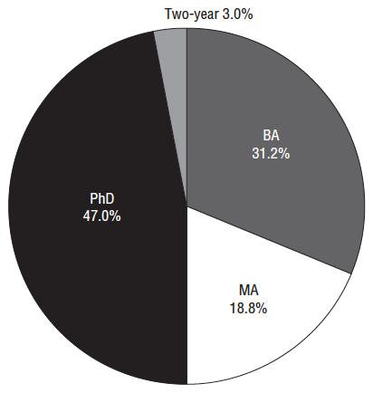
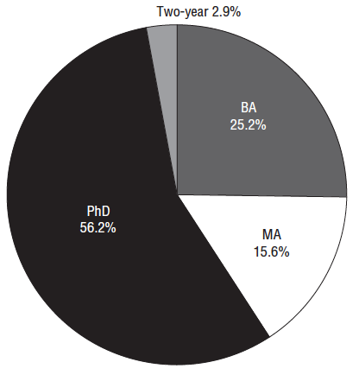
Modern Language PhDs: Placement 2003-04
Tenure-track placements
All placement types
(Steward, 2007)
Notes:
And about a ½ of FL graduate students will go on teaching in institutions where the bulk of their teaching will happen at the undergraduate level.
TRANSITION: So we might assume that given the sizeable portion of instruction provided by graduate students, given that a sizable portion of them will take up positions in BA and MA institutions where a good share of their teaching will be at the undergraduate level and the MLA recommendations to transform the content and goals of the curriculum, we would have expected that there would be strong statements in the Report concerning new directions for FL graduate student professional development …

Slide 8
2007 MLA Report: Proposals for FL graduate students’ professional development as teachers
“graduate studies should provide substantive training in language teaching and the use of new technologies” (p. 7)
“teach graduate students to use technology in language instruction and learning” (p. 9)
Notes:
In fact, the Report's only related comments were … Both of which are fairly minimal.
TRANSITION: The problem with these recommendations

Slide 9
The problem with these recommendations
“[I]f the only teacher preparation available is language teacher
preparation a clear message is sent that language gets taught, but
the corollary collocation for literature remains awkward. A further
part of the message communicated within the structure of the
traditional methods course is that language and literature are clearly
separable units. As long as this message is sent from the outset of the
graduate student socialization process, the ‘lang-lit split’ will remain
entrenched in graduate departments.” (Bernhardt, 2001, p. 199, our
emphasis)
Notes:
TRANSITION: At this point, we would like you to get in small group for a brainstorming activity

Slide 10

Brainstorming
Activity

Slide 11
Discuss/reflect activity: The FL TA training paradigm
In your groups, identify key aspects of the long-standing collegiate FL TA training paradigm:
  Which two aspects do you consider to be most beneficial?
  What are two limitations or shortcomings of this paradigm?
How certain are you of the following? (SA – SD)
  The collegiate FL TA training paradigm meets the long-term needs of FL TAs to teach lower-level language courses.
  The collegiate FL TA training paradigm meets the long-term needs of FL TAs to teach upper-level literary-cultural content courses.
  The concepts and activities associated with the longstanding collegiate FL TA training paradigm prepares TAs to teach language, literature and culture in an integrated fashion, consistent with the aims of the 2007 MLA Report.
Notes:
Make mental notes of what participants are saying

Slide 12
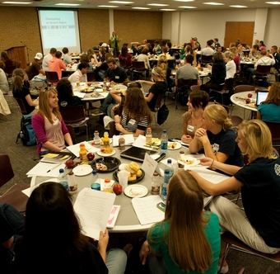
Long-standing collegiate
FL TA training paradigm
Notes:
Now let’s look for a moment at 3 challenging aspects of FL graduate students’ preparation as teachers-
HOW we try to accomplish it
WHAT it consists of, and
WHEN in happens,

Slide 13
Shortcomings of long-standing collegiate FL TA training paradigm
The how
  Dominance of the transmission model (Johnson, 2009)
The what
  Teaching literature and culture-an afterthought (Byrd, 2007; Mills, 20122; Wilbur, 2007)
  Conceptual eclecticism (Wilbur, 2007) in the “post-methods” era (Kumaradivelu, 2001)
The when
  Persistence of “frontloading” (Freeman, 1993), limited scope (Allen & Negueruela, 2010), unsystematic / sporadic ongoing professional development (Allen, 2011)
Notes:
In the transmission model, it is assumed that Novice TAs can apply theoretical ideas related to FL teaching and learning introduced in the methods course and training workshops to their classroom teaching practice. Several studies question whether novice TAs are able or willing translate theory to practice during early in-service methods courses.
The strategies and techniques for teaching lower-level FL courses traditionally introduced in the first year of professional development are not useful for later literary-cultural teaching assignments. The “post method condition” (Kumaravadivelu, 2001) often results in eclecticism as instructors grapple with “the plethora of methodologies that have been devised and promoted as responses to the profession’s quest to identify effective instructional practices as determined by SLA research” (Wilbur, 2007, p. 87). There is also a lack of focus on strategies for teaching literary-cultural content / texts in the methods course may not adequately prepare TAs for their long-term teaching responsibilities (Mills, 2011; Mills & Allen, 2007).
The notion that teachers can be equipped from the outset with everything they need to know for the rest of their career is also highly problematic.

Slide 14
Consequences of these shortcomings:
Evidence from empirical studies
How / Approach: Lack of appropriation of concepts, internationalization of pseudo-conceptual understanding of theoretical notions (Allen, 2011; Dassier, 2011; Fox, 1993), lack of teacher agency in light of perceived constraints (Allen, 2011; Dupuy & Allen, 2012)
What / Content: Lack of “transfer” of confidence in the ability to teach language to confidence about teaching literature (Mills, 2011; Mills & Allen, 2008)
When / Timing: Lack of theory-practice connections in teaching during early semesters (Dupuy & Allen, 2012; Brandl, 2000; Rankin & Becker, 2006), little research on later development
Notes:
In our research we have found that novice teachers struggle to appropriate concepts and lack agency when dealing with the constraints they experience.
Mill's (2011) study of ten doctoral students of French, found that the participants had extensive vicarious experience observing literature professors but little to no mastery experience teaching literature themselves. Moreover, they felt uncertain about their ability to translate techniques for teaching language into teaching literature. Thus, Mills concluded that "although the TAs may possess valuable pedagogical knowledge and content knowledge, they typically do not possess the tools to independently intersect their content knowledge of literature with their knowledge and practice of second language acquisition."
Brandl's (2000) study of graduate students in five different languages, he found that they rated informal discussions about teaching with peers or their supervisor as more influential than orientation activities, the methods course, and teaching workshops. The author concluded that this was due to two factors: First, the amount of information introduced in initial pedagogy courses makes it difficult to process, apply and synthesize; and second, the relation of theory to classroom teaching is a struggle for new teachers.

Slide 15
Proposals to answer these shortcomings
Require additional graduate coursework on SLA pedagogy beyond the “methods course”
Augment teaching experiences:
  Team-teaching (graduate student/faculty) undergraduate courses beyond the lower-level sequence
  Graduate students independently teaching undergraduate courses beyond the lower-level sequence
Notes:
For the challenge of the transmission model - there have been limited but varying recommendations.
One question immediately comes to mind:
Are we not trying to do what has been done in the undergraduate curriculum here? Parallel with the “bridge course as solution for everything” – if you just add this ONE magic element, everything else will fix itself.
TRANSITION – HAVE THESE PROPOSALS BECOME REALITY?

Slide 16
Have these proposals been implemented?
 | Scholarship | Teaching
Year 1 | 1 pedagogy course, 5 literature/cultural studies/theory/language courses | Elementary language courses highly likely (69.9%*)
Years 2-3 | literature/cultural studies/theory/language courses, pre-dissertation exams | Elementary (46%) more likely than intermediate language courses (33%); advanced undergraduate unlikely (8.6%)
Year 4 & beyond | Dissertation proposal / Dissertation | Varies, intermediate language, most likely (36%); advanced undergraduate courses, less likely (19.1%)
* All figures from Steward (2006), culled from MLA data from 158 collegiate FL departments
Notes:
Allen & Negueruela survey of LPDs – 24 respondants, 21 worked in programs with one required 3 credit methods course (1 no credit methods course, two required methods + 1 other pedagogy course).
To summarize, in light of renewed calls for change in undergraduate foreign language instruction such as the 2007 MLA Report, a need exists to reconsider several limitations of the traditional FL TA training paradigm: conceptual eclecticism in content, lack of theory-practice connections, and little emphasis on strategies for teaching literary-cultural content. As Wurst (2008) advocated, we need to “re-examine best practices in training our graduate students so that they will be able to, for example, negotiate the literature/language split” and move beyond the “lecture-discussion model of their professors” (pp. 58-59).

Slide 17

New model for FL TA professional development:
Thinking broadly and long-term
Notes:
We are going to need to think differently, radically differently. Tweaks to the how, what, when is not enough.
Some proposals – caveat: although we are arguing for a particular theoretical framework (SCT) and overarching concept (literacy), we think the more important issue here is to identify the most appropriate theoretical framework and overarching concept/s based on the LOCAL CONTEXT – not a “one size fits all” situation

Slide 18
Answering shortcoming 1: Moving beyond the transmission model
Principles | Examples of related professional development practices
Teachers are learners of L2 teaching | Instructional portfolio Lesson study (planning, teaching, revising)
Learning to teach is a dynamic process of social interaction | Lesson study (planning, debriefing)
Teacher learning is both internal & collective activity | Sustained forum participation / CoP
Professional development is a conceptual process | Concept mapping
Notes:
Teachers are learners of teaching NOT performers, thus professional development practices need to align with this notion
Learning to teach is a dynamic process of social interaction: dialogue is the site of learning, not simply memorization and reproduction of techniques and behaviors
Teacher learning is both internal and collective: not just inside the individual teacher’s mind but among teachers
Professional development is a conceptual process – gradual, learning to think through concepts happens in steps and to get to the level of mastering and being capable of applying conceptual knowledge to teaching practices takes many years;

Slide 19
Answering shortcoming 2: Anchoring professional development activities in an overarching concept
Identify an overarching concept that provides the foundation for L2 instruction and FL TA professional development
Offer professional development activities that link the overarching concept and other related conceptual tools with associated pedagogical tools (i.e., classroom teaching techniques) that can have a lasting impact on teaching and learning
Place text-based instruction at the center of student teaching and teacher learning
Notes:
TRANSITION: Now we want to briefly outline four key concepts related to literacy-based teaching, starting with the concept of literacy itself

Slide 20
Literacy as an overarching concept
“[T]he use of socially-, historically-, and culturally
situated practices of creating and interpreting meaning
through texts. It entails at least a tacit awareness of the
relationships between textual conventions and their
contexts of use and, ideally, the ability to reflect
critically on those relationships . . . literacy is dynamic
not static and variable across and within discourse
communities and cultures” (Kern, 2000, p. 16)
Notes:
TRANSITION: To 7 principles of literacy

Slide 21
The 7 principles of literacy
Interpretation
Collaboration
Convention
Cultural knowledge
Problem-solving
Reflection and Self-reflection
Language use (Kern, 2000)
Notes:
Mindful of the difficulty of translating such a definition into the concrete realities of, Kern further elaborated seven principles of literacy to guide teaching practice including: Interpretation, Collaboration, Conventions, Cultural knowledge, Problem-solving, Reflection and Self-reflection, and Language use. Whereas language use, conventions, and cultural knowledge represent core elements of literacy-based instruction, they are taught in conjunction with the processes of interpretation, collaboration, problem solving, and reflection. According to Kern, “this seven-point linkage between literacy and communication has important implications for language teaching, as it provides a bridge to span the gap that so often separates introductory ‘communicative’ language teaching and advanced ‘literary’ teaching” (p. 17). TRANSITION TO AVAILABLE DESIGNS

Slide 22
Available designs
LINGUISTIC SCHEMATIC
← ------------------------------------------------------------→
writing system formal schemata
vocabulary genre / style
syntax content schemata
cohesion / coherence stories
Notes:
A key element of literacy-based pedagogy is design of meaning. Design is an active, dynamic process that involves he creation of form-meaning connections through interpretation or creation of texts. So this conception expands the typical focus in L2 instruction from a near exclusive focus on the linguistic available designs of grammar and vocabulary to include both other types of linguistic Available Designs as well as schematic Available Designs.
TRANSITION: So how does a literacy-based approach instantiate these ideas in classroom practice?

Slide 23
The four curricular components
Situated practice = experiencing
  Spontaneous, experiential learning without conscious reflection
Overt instruction = conceptualizing
  Explicit learning / instruction of skills and knowledge needed for competent participation in activities
Critical framing = analyzing
  Relating meaning to social contexts and purposes
Transformed practice = applying
  Application of new understandings, knowledge, and skills to use knowledge and produce language in creative ways
(Cope & Kalantzis, 2009; New London Group, 1996)
Notes:
The four curricular components provide the pedagogical structure to organize instruction and engage learners in acts of meaning design. They are neither hierarchical nor sequential; they are sometimes overlapping parts of a complete pedagogy that may be implemented in whatever order best meets students’ literacy needs.
TRANSITION: To synthesize …

Slide 24
New London Group (1996), Kern (2000)
Notes:
Transition: And finally, looking at how we might respond to the third shortcoming related to FL TA professional development

Slide 25
Answering shortcoming 3: From narrow and short-term to broader and long-term FL TA professional development
Implementing sustainable, collaborative professional development models and activities
  Exploratory practice (Crane, Sadler, Ha, & Ojiambo, 2013)
  Lesson study (Dupuy & Allen, 2012)
  Lesson-planning group projects (Paesani, in press)
  Ongoing goal setting and reflection (e.g., portfolio, blogging, etc.)
Working toward breaking down the literature-pedagogy divide in graduate curriculum structure
  Treating issues of teaching in literature seminars and treating issues of literature in L2 teaching seminars (Reeser, 2013; Allen, 2010)
Notes:
TRANSITION: So this need to develop sustainable, collaborative professional development activities was the driving force in the development of the PERCOLATE modules, which we’ll now preview for you.

Slide 26
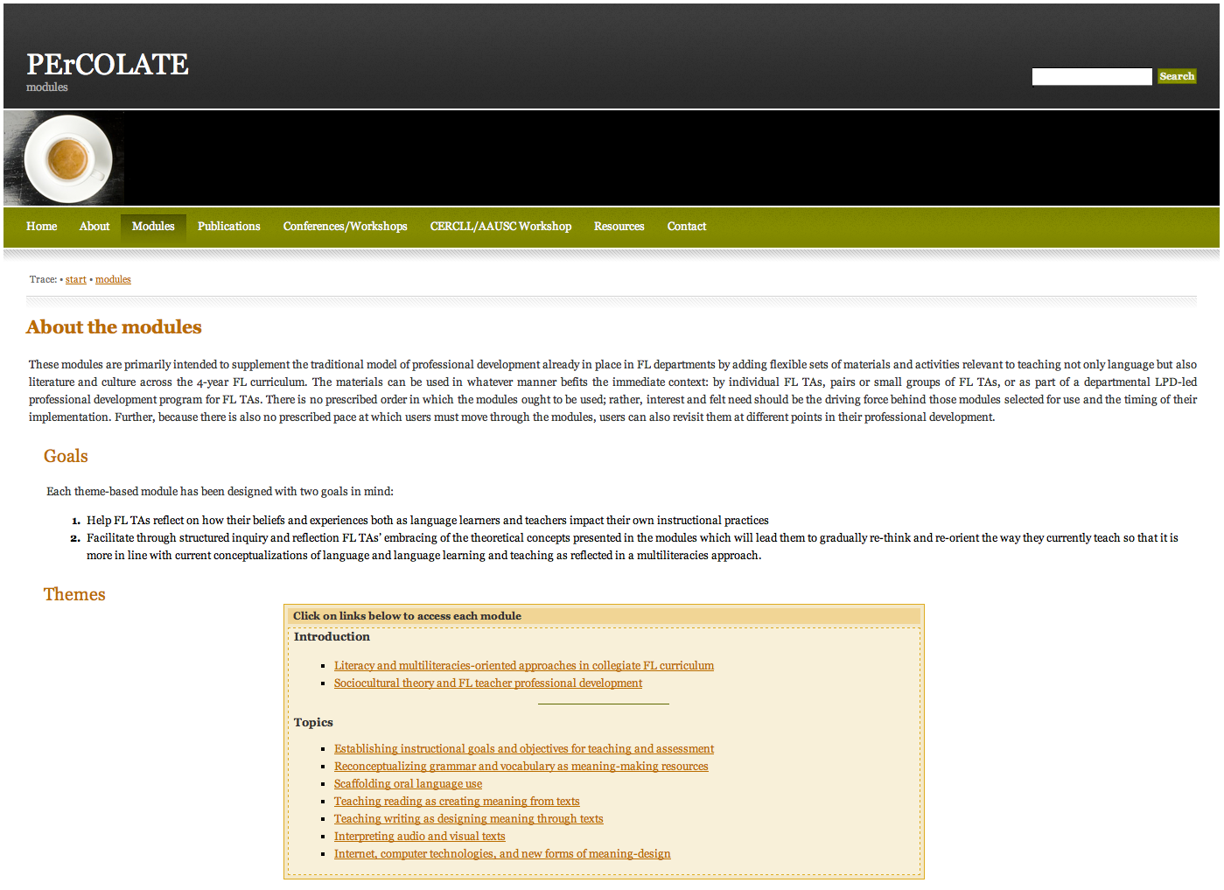
Project PErCOLATE:
Addressing shortcomings of FL TA professional development

Slide 27
Project description
Flexible sets of modules with materials and activities to teach language and literature/culture across the 4-year FL curriculum.
  Can be used to supplement an existing “methods” course.
  Can be used by individual FL TAs, pairs or groups of FL TAs, or as part of a departmental LPD-led professional development program for FL graduate students beyond the “methods” course.
  Can be used at multiple entry points of a FL graduate student career based on interest or need.
Notes:
Transition: So how does PERCOLATE relate to the 2007 MLA Report’s calls for change?

Slide 28
How PErCOLATE attempts to respond to the 2007 MLA Report’s call for change
Curricular content
  Materials and activities that:
    answer FL graduate students’ immediate and long-term teaching needs
    prompt FL graduate students to rethink connections between language, literature and culture through the overarching concept of literacy
Departmental governance
    Materials and activities that seek to prepare agentic teachers who:
        take an active role in shaping the content of the courses they teach and the form of their professional development over the years
        view collaboration as central to teaching and professional development
Notes:
Transition to PERCOLATE module themes

Slide 29
PErCOLATE modules: Themes
Introductory modules
  Literacy as an overarching concept
  Sociocultural theory & teacher education
Instructional goals & objectives
L2 grammar & vocabulary as meaning-making resources
Scaffolding of oral language use
Reading as meaning-making
Writing as designing meaning
Interpreting audio & visual texts
Internet, new technologies
Notes:
Ready for use in Fall 2013, mention the book; TRANSITION: Module components

Slide 30
PErCOLATE module components
Topic overview
List of key concepts
Questions to consider
List of core readings along with pre- and post-reading reflection questions
Pedagogical application activities (2-3)
Reflective teaching journal prompt
List of additional resources

Slide 31
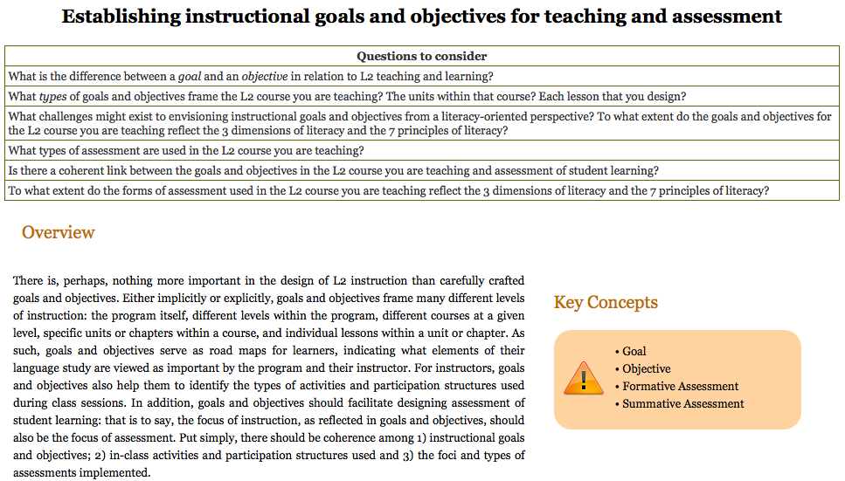
Sample module
Notes:
TRANSITION: Three different uses for these materials

Slide 32
Use of sample unit for a graduate seminar
Prior to class session 1: Reading of Overview and core readings, completion of pre- and post-reading questions on course discussion board or class blog
During class session 1: Discussion of core readings and student responses to pre- and post-reading questions
Prior to class session 2: Completion of pedagogical activity 1—analysis of textbook goals and objectives and alignment with literacy-based FL teaching
During class session 2: Discussion of pedagogical activity 1, completion of pedagogical activities 2 and 3 in small groups
After class session 2: Completion of reflective teaching journal prompt
Notes:
2 X a week 75 minute format; TRANSITION: Use of module for one workshop

Slide 33
Use of sample unit for an individual workshop
Prior to workshop: Participants read overview to topic
Workshop outline
  Powerpoint presentation of main ideas from core readings by workshop leader (30 minutes)
  Completion of pedagogical activity 1 or 2 in small groups (30 minutes)
  Sharing and discussion among groups (30 minutes)
After workshop: Completion of reflective teaching journal prompt
Notes:
Transition: Use of module over the course of a semester, more sustained effort

Slide 34
Use of sample unit for a series of workshops
Prior to Workshop 1: Participants read overview to topic and core readings, completion of pre- and post-reading questions
Workshop 1: Discussion of core readings
Prior to Workshop 2: Completion of pedagogical activity 1
Workshop 2: Discussion of pedagogical activity 1 and consequences for reshaping goals, objectives and assessment related to TAs’ textbooks
Prior to Workshop 3: Completion of pedagogical activity 2
Workshop 3: Discussion of pedagogical activity 2 and joint completion of pedagogical activity 3
After Workshop 3: Completion of reflective teaching journal prompt
Notes:
These would be scheduled 1/month over one semester

Slide 35
Synthesis: the PErCOLATE project and FL TA professional development
Moving beyond the transmission model: Participating in both individual and collective activities
Moving beyond eclecticism in teaching: Anchoring ongoing professional development in literacy-based concepts
Moving beyond immediate needs of first-time teachers: Focusing on elements of teaching salient for teaching across the curriculum

Slide 36
Questions? Comments?
bdupuy@email.arizona.edu
hwallen@wisc.edu
The PErCOLATE Project
http://www.percolate.arizona.edu/doku.php
Related forthcoming publication in Fall 2013:
Paesani, K., Allen, H. W., Dupuy, B. A multiliteracies framework for collegiate foreign language teaching. Pearson, Prentice Hall Second Language Library Series.

Slide 37
Thank you

