Slide 1
Appropriating and Using Conceptual Tools of Literacy:
The Development of Teaching Expertise by
Future FL Faculty
Heather Willis Allen, University of Miami
Beatrice Dupuy, University of Arizona

Slide 2
Rationale for the study
Given recent calls (e.g., MLA 2007 Report) to better integrate the study of language and culture in the undergraduate FL curriculum, the effectiveness of professional development for today’s FL graduate students is ever more salient.
However, little empirical research has investigated the development of teaching expertise for graduate student instructors (GSIs) or the specific outcomes of their participation in professional development on their teaching cognitions and practices.
Notes:
So when we say GSIs we mean MA or PhD level students enrolled in a graduate program through a university FL department

Slide 3
Background
GSIs play an important role in undergraduate FL education, teaching more than one half of elementary-level language courses in Ph.D.-granting departments (MLA, 2007)
The dominant model for GSI teacher preparation is flawed & is consistent with Freeman’s (1993) notion of frontloading, i.e., attempting to equip teachers at the outset for all they need to know & be capable of doing throughout their career
This model for GSI teacher preparation is also problematic given the historic language-literature divide in U.S. collegiate FL departments
Notes:
This study explores how conceptual understandings & teaching practices evolved for 17 GSIs during & after participation in a seminar on literacy-based FL teaching & learning.
In particular, four research questions are explored:

Slide 4
Research Questions
What roles do GSIs' language teaching/learning-related beliefs play in their evolving conceptual understandings of literacy and its application to FL instruction?
What are the learning outcomes for GSIs of participating in a one-semester seminar introducing them to conceptual and pedagogical tools of literacy?
How do GSIs instantiate conceptual knowledge related to literacy in the FL classroom?
Which activities and tools from the seminar contributed most to GSIs’conceptual understandings?
Notes:
MENTION THAT WE ARE NOT GOING TO LOOK AT QUESTION #3 TODAY

Slide 5
Conceptualizing teacher learning from a sociocultural theory perspective
Teachers are learners of L2 teaching rather than performers of teaching
Learning to teach is as a dynamic process of social interaction wherein teachers appropriate, reconstruct, & transform existing social practices of teaching based on individual & local needs
Teacher learning is both internal & collective activity that shapes not only teachers' own actions & thoughts but also student engagement in learning & learning outcomes
Professional development is a conceptual process, wherein L2 teachers' own everyday concepts of language, learning, & teaching encounter scientific concepts about these subjects embraced by their profession, creating the potential for reorganization of experiential knowledge & formation of new knowledge. The use of one overarching concept can unify curricula & provide teachers with coherent notions of FL teaching & learning
(Johnson, 2009; Lantolf & Johnson, 2007; Smagorinsky, Cook, & Johnson, 2003)

Slide 6
Theoretical framework: Levels of appropriation of conceptual & pedagogical tools
Lack of appropriation due to incomprehension, resistance, or rejection
Appropriating the concept’s label but none of its features
Appropriating surface features of the concept but not understanding how various features contribute to a conceptual whole
Appropriating conceptual underpinnings & being able to use the concept in new settings
Achieving mastery in implementing the concept
Grossman, Smagorinsky, & Valencia (1999)
Notes:
Conceptual tools mediate decision making for planning, instruction, and assessment and include theoretical principles, concepts, and frameworks
Pedagogical tools have more local, immediate utility and include instructional practices, strategies, and resources (Grossman, Smagorinsky, & Valencia, 1999).
The distinction between the two types of tools is significant as novice teachers often encounter difficulty instantiating pedagogical applications of theoretical concepts and frameworks.
Development depends on the availability of teachers’ opportunities for dialogic mediation, scaffolded learning, and assisted performance (Johnson, 2009)
Eun (2008): it is critical that those providing assistance (e.g., a GSI supervisor) have the ability to accurately assess the current and potential levels of development for each teacher to facilitate its emergence

Slide 7
Research design: The participants
Cross-institutional: Two R1 universities, one public & one private
17 GSIs
  4 males, 13 females; ages: 22-42
  9 Ph.D. students; 8 M.A. students
Cross-language: Spanish (4), German (4), Russian (3), French (3), Japanese (2), Korean (1)
Participants’ previous FL teaching experience: No (11), Yes (6)
Notes:
WE WILL ONLY DISCUSS TWO PhD level of PARTICIPANTS
AMANDA, ELENA

Slide 8
Research design:
The course objectives
Familiarity with theoretical foundations of second / foreign language acquisition and a range of practical applications and implications for communicative, literacy-oriented language teaching
Conceptual understanding of principles of communicative, literacy-oriented language teaching
Conceptual understanding of classroom techniques for communicative, literacy-oriented language teaching
Ability to design materials, lessons, and assessment instruments consistent with conceptual and pedagogical tools of literacy-oriented language teaching introduced over the course of the semester
Critical insights about teaching language through cultural texts of all types to develop literacy in the foreign language
Notes:
linking theory (understanding of principles) to practice (understanding techniques, designing instruction) through a number of activities that I will describe in a moment
14 week course, 2.5 hour sessions, 30-45 minutes of « workshop » at the end of each session to collaboratively prepare part of a lesson using a literacy-based model for an instructional sequence

Slide 9
Research design: The course—
Framing concepts
Literacy: “dynamic, culturally and historically situated practices of using and interpreting diverse written and spoken texts to fulfill particular social purposes” (Kern, 2000, p. 6)
Principles of literacy-based FL teaching: 7 principles of literacy, design (Available Designs, Designing and the Redesigned)
Curricular components: situated practice, overt instruction, critical framing, transformed practice (New London Group, 1996)
Notes:
Literacy as the framing concept – both a process and a goal
7 principles of literacy: language use, cultural knowledge, conventions, interpretation, collaboration, problem solving, reflection and self reflection
-> what to teach (content) and how to teach (learning processes learners are engaged in)
Available designs: linguistic and schematic resources
Types of recurrent activities that constitute a literacy-based pedagogy; not sequential – not a method SP & OI are more consistent traditional FL pedagogies whereas CF and TP are not

Slide 10
Research design: Data collection and analysis
Data sources: Pre- and post-semester questionnaires, weekly reading blog postings, bi-weekly reflective teaching journal, concept maps, lesson study documents (3 cycles), instructional unit materials, post-semester interview
Analysis of narrative data: Double coding for mentions of concepts related to literacy-based teaching & the level of appropriation evidenced in each mention; focus on how concepts are being understood, transformed, and instantiated
Notes:
EXPLAIN WHAT LESSON STUDY IS BRIEFLY. LESSON STUDY IS AN APPROACH TO PROFESSIONAL DEVELOPMENT WIDELY USED IN JAPAN.
In lesson study “teachers engage in to systematically examining their practice, with the goal of becoming more effective ... centers on teachers working collaboratively on a small number of "study lessons” from planning to teaching to observing, and critiquing the lessons.
The teachers select an overarching goal and related research question that they want to explore. This research question then serves to guide their work on all the study lessons”.

Slide 11
Case 1: Amanda
Pre-semester demographic information
  25 year-old American female
  BA in Art History/Spanish, MA Spanish, PhD candidate in Spanish
  Taught 1st year Spanish during her MA
Pre-semester notions of FL teaching
  Important elements of FL teaching: Developing proficiency & maintaining in-class immersion
  Priorities of FL teaching: Providing an immersion-like classroom where students feel comfortable & want to participate
  Biggest anticipated challenges: Getting away from direct in-class grammar instruction
Notes:
Well versed in communicative language teaching from her previous Spanish teaching during her MA

Slide 12
Case 1: Amanda
Developing conceptual knowledge of literacy
  Pre-course notions of literacy/being literate (08/25/2010)
    “the ability to read and write almost every word in one’s native language … the ability to comprehend a majority of spoken or written language. I would imagine that it would also entail being ‘literate’ in the particular nuances of a culture.”
  Reflective journal entries
    RJ 4 (10/12/2010) Midterm reflection & concept map
    RJ 7 (11/30/2010) Final reflection & concept map
  Post-semester interview (12/7/2010)
Notes:
If you look at your handout ...
Now let’s compare her fourth and seventh reflective journal entries
The fourth RJ evidences the fact that she is foregrounding the pedagogical framework that she had used in her previous teaching experiences – CLT – « four skills » « vocabulary/grammar » with the addition of a new focus on texts - SHOW CONCEPT MAP
The seventh RJ shows a more integrated approach to teaching language and culture through texts and « four skills » and « grammar/vocabulary » are now seen as she worded it « means to higher objectives rather than a principal objective ». Addition of the four curricular components. SHOW CONCEPT MAP

Slide 13
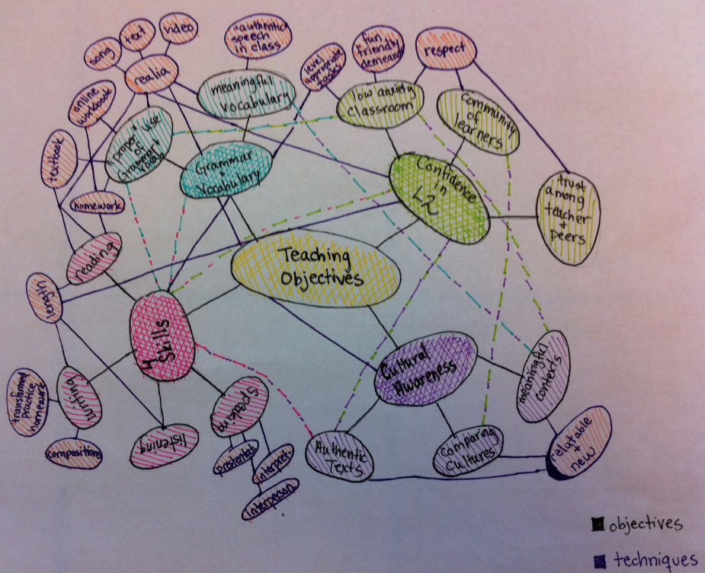
Concept map: Midterm

Slide 14
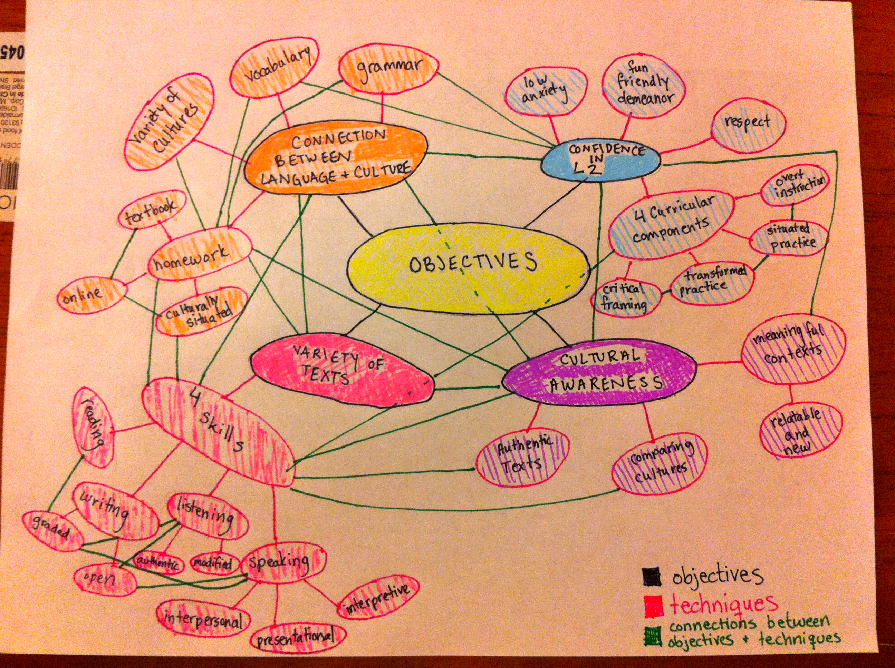
Concept map: End of semester

Slide 15
Case 1: Amanda
Applying conceptual and pedagogical tools of literacy in instructional design
  Reflective journal entries
    RJ 4 (10/12/2010) Midterm reflection
    RJ 6 (11/9/2010 ) Teaching lesson reflection
  Post-semester interview (12/7/2010)
Notes:
RJ #4: Claims to use texts in a new way, evolution in her view and uses for the textbook as a tool that mediates student learning
RJ #6: Demonstrates the ability for the first time to think through literacy-based concepts in constructing practice. Alignment between conceptual and pedagogical tools. For example, in step 3 of her lesson, she lables this activity situated practice but goes beyond just the label to show that she has an awareness of the underlying principles of this curricular component. She also links the conceptual tool of situated practice to the use of a matrix as a pedagogical tool
Final interview: the role of text-based rather than textbook-based instruction and « integration of skills » rather than four skills

Slide 16
Case 2: Elena
Pre-semester demographic information
  39 year-old Cuban female
  MA in International Relations (US), Ph.D. candidate in Romance Literature, concentration in Spanish Literature
  No previous FL teaching experience
Pre-semester notions of FL teaching
  Important elements of FL teaching: Consistency, organization & choosing a right method
  Priorities of FL teaching: Consistency, organization & choosing a right method
  Biggest anticipated challenges: Meeting the school’s & students’ expectations
Notes:
Absence of scientific concepts – no previous FL teaching experience or previous methods course -> dominance of everyday concepts
Biggest anticipated challenges are not pedagogical

Slide 17
Case 2: Elena
Developing conceptual knowledge of literacy
  Pre-course notions of literacy/being literate (08/25/2010)
    “the acquisition of minimal educational requirements which allow persons to navigate in an educational or cultural system … it means to not feel intimidated to produce in a FL despite the mistakes (grammatical or others) that you would eventually do”
  Reflective journal entries
    RJ 4 (10/14/2010) Midterm reflection & concept map
    RJ 7 (11/30/2010) Final reflection & concept map
Notes:
Pre-course notion of literacy: Literate / not literate “minimal educational requirement” she also specifically focuses on grammar
RJ #4: First concept map demonstrates a non-integrated approach to teaching language and culture as well as Vocabulary and Grammar as objectives in and of themselves. Insists that “these objectives are in line with the framework on the literacy teaching approach” – SHOW CONCEPT MAP
Heavy focus on grammar and vocabulary: Notion that you learn the rules before “meaning creation and production” -> shows the continued reliance on her own beliefs and everyday notions of language learning even after 7-8 weeks of the methods semianr
RJ #7: Some shift in what she claims as her pedagogical objectives -> example of “vocabulary and grammar are not necessarily ends in itself” but now Communication “is my guiding teaching principle” - mentions 6 of the 7 principles of literacy. What is not present: 4 curricular components, specific pedagogical tools to instantiate literacy-based teaching
We still see resistance to the notion that transformed practice is feasible for a beginning level class

Slide 18
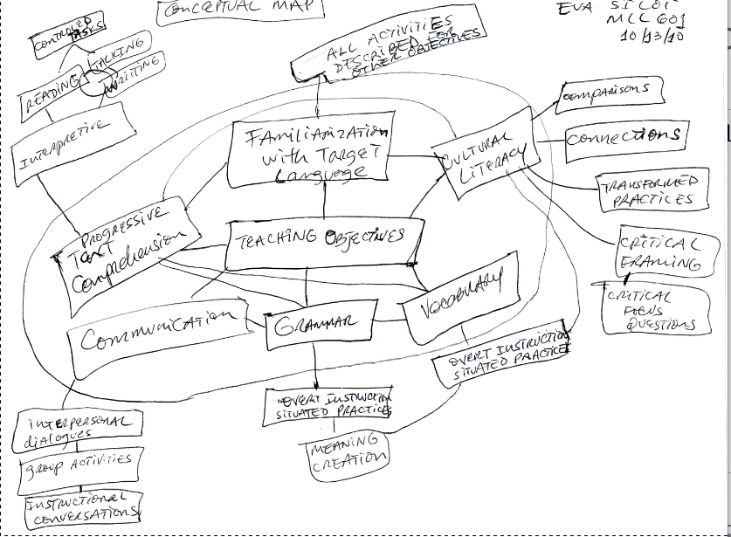
Concept map: Midterm

Slide 19
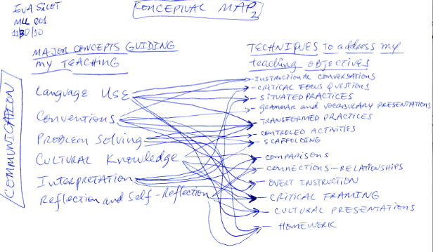
Concept map: End of semester

Slide 20
Case 2: Elena
Applying conceptual and pedagogical tools of literacy in instructional design
  Reflective journal entries
    RJ 2 (9/12/2010)
    RJ 6 (11/10/2010 ) Teaching lesson reflection
  Post-semester interview (12/7/2010)
Notes:
RJ#2: Although it is a text-based lesson, the text is used as a tool for introducing a grammatical point.
No mention of scaffolding of students’ reading of the text on her part – she only mentions her students’ frustration
The outcome of students’ participation in the lesson is expressed in terms of their grasp of the use of the verb. Continued dominance of vocabulary and grammar as her focus.
RJ #6: In a lesson on holidays and activities, overt instruction and situated practice is centered on vocabulary and grammar and the text is not brought into the lesson until later and students are left to read and write a letter without, apparently, scaffolding. No focus on interpretation is evident.
Elena does point out that the TP and CF activities « proved difficult for students » and that the students « elaborated letters without taking too much into consideration the information provided in the basic texts » but she does not seem to be able to take into account the pedagogical actions she could take to make their participation in these activities more effective – no mention of specific literacy-based pedagogical tools for carrying out CF and TP
-In comparison to Amanda who described the same lesson but demonstrated a deeper conceptual understanding of the curricular components and alignment between conceptual and pedagogical tools

Slide 21
Emerging themes
Structuring teaching practices through concepts of literacy proved overall difficult for these novice teachers, more for some than others. Levels of appropriation evidenced by each participant:
    Amanda –Appropriating surface features -> conceptual underpinnings
    Elena –Appropriating a label -> surface features
Activities & tools that were perceived as the most valuable affordances for enhancing conceptual understanding of literacy-based FL teaching:
    Lesson study (Amanda, Elena); Reading & blog reactions (Amanda); Class discussions (Amanda); Workshop handouts (Amanda, Elena); PPTs (Amanda, Elena)
Constraints to literacy-based FL teaching:
    Time (Elena), lack of ready-made materials (Elena), textbook (Amanda, Elena), syllabus (Amanda)
Notes:
Among participants, conceptual development varied considerably, and some participants struggled to reconcile their own personal notions of language learning and concepts related to other instructional approaches (i.e., CLT) with literacy-based concepts.
Although participants claimed to use at least one conceptual or pedagogical tool of literacy in their teaching after the seminar, not all demonstrated alignment in constructing their teaching practices through conceptual and pedagogical tools of literacy. Whereas Amanda appeared to “think through” theoretical concepts of literacy in choosing pedagogical tools or instructional strategies, Elena and Ryoko seemed to pick pedagogical tools, sometimes parts of pedagogical tools, in a less systematic fashion and without explicitly grounding their choices in a literacy-based framework.
Despite each participant reading research on literacy-based FL teaching and writing blog reactions on them, dialogic mediation of their understandings of that research through discussion with peers and their instructor, and assisted performance in carrying 3 lesson studies, these findings demonstrate the gradual and difficult process of conceptual development. Theoretical understandings of literacy did emerge although in various degrees among participants after the methods course,however identical paths of conceptual development did not, asserting the notion that teachers do not simply accumulate theoretical knowledge and put it into action.
One thread emerging in this study was the role of participants’ everyday notions of language learning, beliefs, and previous experiences (particularly in methods courses focused on other instructional approaches) in mediating their conceptual understandings of literacy and its application in the undergraduate FL curriculum. Constraints such as time, lack of available materials, textbook in use and syllabus also As Vygotsky wrote, conceptual development is truly a “twisting path” (p. 156), even when, as this study shows, it is supported by multiple and sustained professional development activities.

Slide 22
Conclusions and future directions
Instantiating literacy-based FL pedagogy is tremendously challenging for GSIs and the ability to “think through” literacy-based concepts in constructing teaching practices is a gradual, often difficult process
The traditional model of a one-semester methods seminar as the primary means of facilitating theory-practice connections for novice FL GSIs is insufficient
“[T]he changes required in TA education are so pervasive as to be beyond one’s professional reach ... it will not suffice to leave untouched the marginal position of TA education within the intellectual-academic work of graduate programs. It is unsatisfactory to retain the structures that have institutionalized that marginalization and even trivialization of language instruction” (Byrnes, 2005, p. 136)
Notes:
In a previous investigation (Allen in Johnson & Golombek 2011) it was found that demonstrating the appropriation of conceptual underpinnings of literacy-based teaching on a consistent basis only emerged after 6 semesters of teaching

Slide 23
Conclusions and future directions
Future research should continue to explore:
  the longitudinal emergence of conceptual development by FL GSIs
  which in-service professional development activities are most effective for supporting this developmental trajectory

Slide 24
For more information
This presentation & related publications:
http://works.bepress.com/heatherwillisallen/
Further information on the PERCOLATE project:
http://cercll.arizona.edu/doku.php/projects/materials
Further information on FL teacher professional development taking a conceptual and literacy-based approach:
http://cercll.arizona.edu/doku.php/development/workshops

