Slide 1
Theme-based bridge courses:
A gateway to advanced linguistic proficiency
Heather Willis Allen Stacey Katz Bourns
University of Miami Harvard University
hallen@miami.edu skatz@fas.harvard.edu

Slide 2
Overview
Rationale: Integrating linguistic and cultural-literary content in undergraduate FL courses
Characteristics of “bridge” courses
Example 1: A multiliteracies approach to “Advanced Stylistics & Composition”
Example 2: A discourse-based approach to “Modern Stories about Paris”
Questions & Discussion

Slide 3
Rationale: Integrating language & content
“The language literature dichotomy has been institutionalized in
departments of foreign languages and literatures at North American
universities ... [t]eaching language is consistently viewed as a less
sophisticated, hence less difficult task than teaching literature”
(Kramsch, 1993, p. 7)
“Replacing the two-tiered language-literature structure with a
broader and more coherent curriculum in which language, culture,
and literature are taught as a continuous whole ... will reinvigorate
language departments as valuable academic units central to the
humanities and to the missions of higher education” (MLA, 2007)

Slide 4
The challenge: Integrating language & content
“At the lower level, instruction typically consists of an introduction to the
grammatical canon within a communicatively oriented framework in the
first year and then a thorough review and slight expansion of the canon
within a more textual- and theme-oriented second-year course ... In
contrast to the lower level and its explicit focus on formal instruction, the
upper level in most FL departments makes a pronounced shift toward
toward courses with specific content foci but without any substantive or
systematic attention to learners’ language acquisition” (Maxim, 2008, p.
172)

Slide 5
Characteristics of “bridge” courses
Vary depending on the setting
Not only in language programs: computer science, nursing, etc.
Creating transitions
Filling in the gaps
Preparing for more advanced work
Moving on to the other side
Metaphor after metaphor...

Slide 6
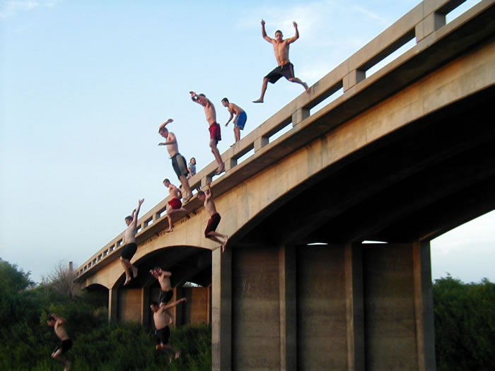
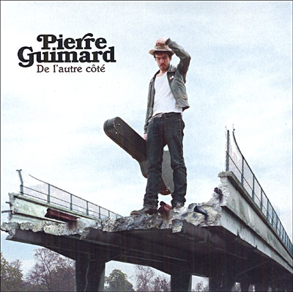
Metaphors we don’t usually use...

Slide 7
Bridge language courses at Harvard: coming up with goals & criteria
General goals for “bridge” courses:
prepare students for upper-level disciplinary courses in social science and the humanities that are taught in the target language (the exact disciplines may vary according to language, based on student interests and research needs)
encourage students to continue their language study
reflect findings in the field of applied linguistics in terms of methodology and content
General criteria for bridge courses:
Bridge courses at Harvard should ...
contain a significant writing component and focus on literacy
in principle focus on the disciplinary content, with the target language used as a medium of instruction, as opposed to the language skills being targeted as an end in themselves
be taught by faculty members, not TAs, except if the latter are under the close supervision of a faculty member

Slide 8
Example 1: A multiliteracies approach to “Advanced Stylistics & Composition”
What does a multiliteracies approach entail?
Recognizing the limitations of CLT for collegiate FL learners
Developing a curriculum anchored in texts: enveloping the textual within the communicative
Viewing reading & writing as both individual & social communicative acts
Sensitizing learners to ...
  the situated nature of language use
  the context surrounding the production & interpretation of a text
  the various linguistic & schematic resources (both L1 and FL) needed to make meaning in the FL & do so in contextually appropriate ways
  (Kern, 2000; Swaffar & Arens, 2005)

Slide 9
Principles of literacy
conventions collaboration
cultural knowledge interpretation
language use problem solving
reflection & self reflection
Kern (2000)

Slide 10
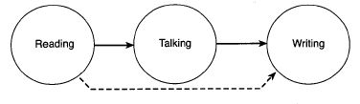
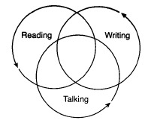
Integrating linguistic modalities in a multiliteracies approach
Kern (2000)

Slide 11
Available designs
learners’ existing knowledge & resources that are drawn on, consciously or unconsciously, in understanding & making meaning from texts (Kern, 2000)
Linguistic Schematic
writing system rhetorical org. patterns
vocabulary knowledge of genres
syntax stylistic choices
cohesion/coherence stories
cultural models
Notes:
Segway from personal views to the MLA Report
Mention multiple volumes dedicated to discussions
of the Standards--Language Learning, FLA, AAUSC
Several editorial columns in MLJ: columns on language education policy in the United States (MLJ 87:4), the relation between the goals of FL study and the metaphors dominating FL pedagogy (MLJ 90:2), and the assessment and evaluation of university-level FL programs (MLJ 90:4).

Slide 12
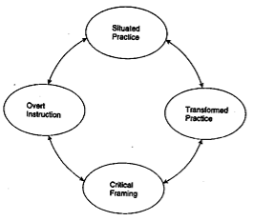
A framework for literacy-based teaching
“[P]edagogy is a complex integration of four factors: Situated Practice based on the world of learners’ Designed & Designing experiences; Overt Instruction through which students shape for themselves an explicit metalanguage of Design; Critical Framing which relates meanings to their social contexts & purposes; and Transformed Practice in which students transfer & re-create Designs of meaning from one context to another” (New London Group,1996, p. 83)
Notes:
Segway from personal views to the MLA Report
Mention multiple volumes dedicated to discussions
of the Standards--Language Learning, FLA, AAUSC
Several editorial columns in MLJ: columns on language education policy in the United States (MLJ 87:4), the relation between the goals of FL study and the metaphors dominating FL pedagogy (MLJ 90:2), and the assessment and evaluation of university-level FL programs (MLJ 90:4).

Slide 13
The course: Advanced stylistics & composition
Context
Course materials
M1 M2 M3 M4
l’art de la l’art de la manipulation l’art de la
description l’observation linguistique narration

Slide 14
The course: goals & objectives (1)
Goal: Students will gain confidence and experience in writing in French by
analyzing stylistic and grammatical elements of several genres of
modern French literary texts and later creating their own French texts.
Objectives:
1. Through analyzing texts of various genres, you will become more
sensitive to relationships between form and content—in other words, you
will formulate answers to the question of why certain linguistic devices are
used in particular textual genres.
2. Through creating written texts compiled in a digital portfolio, you
will gain experience in writing for communicative purposes in French
in a variety of genres.

Slide 15
The course: objectives (2)
3. Through participating in discussions, brainstorming and peer-review
activities, and individual writing conferences, you will develop your abilities
to interact orally in French in advanced ways (e.g., making detailed
descriptions, defending opinions, offering counter arguments, etc.)
4. Through brainstorming, conferencing, and peer-review activities with your
peers and the instructor, you will learn to work as part of a writing community.
5. Through completing tasks requiring the use of tools, both print and online,
in preparing French texts, you will gain familiarity in finding and using
linguistic resources needed to produce effective and accurate writing.
6. Through engaging in goal-setting and self-reflection in terms of your
efforts, difficulties, and accomplishments in the course, you will become
more aware of the process of language learning and your own identity as a
developing foreign language learner.

Slide 16
Sample module organization
Materials: “Petites pratiques germanopratines,”
“Le fait du jour” (Anna Gavalda, Je veux que
quelqu’un m’attende quelque part)
Week 1 | introduction to the author textual analysis | stylistic/linguistic analysis
Week 2 | writing workshop 1 | Draft 1 due & peer review
Week 3 | individual writing conferences | writing workshop 2
Week 4 | Draft 2 due & peer review | Final Draft due & roundtable

Slide 17
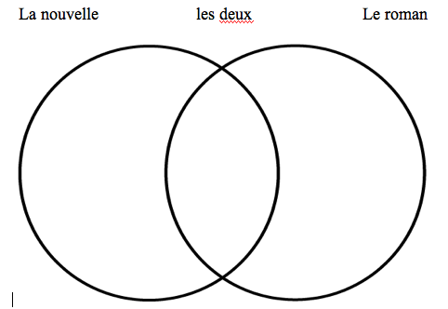
Step 1: Introduction to the genre & author—critical framing
Materials: Interview with Gavalda (Muze),
Biographical information on Gavalda (Lire)
Activity 1: Activating students’ existing knowledge about the genre of short stories (Qu’est-ce qu’une nouvelle? En quoi peut-on distinguer la nouvelle du roman?)
Activity 2: Short
presentation on Gavalda

Slide 18
Step 2: Immersion in genre through textual comparison—situated practice
Materials: the two short stories
Activity 1 (at home): reading and analysis of texts
Activity 2: échange des informations (S <-> S)
Activity 3: comparaison des textes (Ss <-> Ss)
  le conflit
  l’intrigue
  l’ordre du récit
  le dénouement
Activity 4: discussion--“aspects des deux textes qui vous intéressent”

Slide 19
Step 3: Development of a metalanguage for meaning design-overt instruction
Materials: the two short stories, lexicon for cultural terms
Activity 1 (at home): stylistic and linguistic analysis of the two texts
Activity 2: échange des informations (S <-> S)
Activity 3: discussion of key stylistic techniques & effects produced
ex. énumération: “Je travaille, je réponds au téléphone, j’envoie des fax, je termine une maquette” vs. scène descriptive of 45 lines
Activity 4: discussion of key elements of a “Gavaldesque” short story

Slide 20
Step 4: Creating a new text--pre writing activities
Activity 1 (at home): pre-writing--idea map
  content only
Activity 2: exchange of ideas, suggestions (S <-> S, S <-> Ss)
Activity 3: continued elaboration of idea map (individual)
  content + linguistic / stylistic elements
Activity 4: writing the first paragraph, version 1.0 + 2.0 (individual then
S <->S)

Slide 21
Step 4: Drafting (transformed practice) & peer review
Draft of text (at home)
Activity 1a: Partnered peer review -- preparation
  each partner completes a self-evaluation of his draft including a list of difficulties encountered and two questions he/she would like his partner to address
  each person circles the section of the text they like the most and underlines the section they dislike the most
  they then read & evaluate their partner’s text using a similar form
Activity 1b: Partnered peer review -- exchange of ideas
Activity 2: Round table- sharing problems, questions, ideas in groups of 4-6

Slide 22
Step 4: Conferencing, revising, presenting
Individual conferences with the professor
Revision and refinement of the first draft
Peer review session 2 (are all the essential elements included?)
Round table
  Each student presents an excerpt of his or her text
  Students make comments on their colleagues’ texts & how they have developed over the course of the module

Slide 23
Summary – Example course 1
Outcomes:
New understandings of form-meaning connections, i.e., why certain Available Designs are used in certain textual genres
Learning to function as a discourse community & to mutually support each other in the writing & revising process--they weren’t writing only for the professor
Playing with language and further developing their own writerly voices through learning new Available Designs

Slide 24
Example 2: A discourse grammar approach to “Modern Stories of Paris”
Bridge course – Harvard makes a sharp distinction between language and literature courses
Complaints of literature professors:
students are weak in grammar
students do not write well
Goal of this course: improve students’ discourse competence

Slide 25
Communicative Competence
(Canale and Swain, 1980)
Grammatical competence
Sociolinguistic competence
Strategic competence
Discourse competence: the mastery of combining grammatical forms and meanings to achieve a unified spoken or written text in different genres.
“Using a language entails the ability both to interpret and produce discourse in context in spoken and written communicative interaction, which is why we assign such a central role to discourse in our discussion of frameworks that should inform language teaching.” (Celce-Murcia and Olshtain, 2000, p. 4)

Slide 26
How do we teach discourse competence?
Providing models
Analyzing various types of discourse (students working as researchers)
Particularly, we focus on:
spoken vs. written French
linguistic register – formal vs. informal; different genres
discourse grammar in general: narration, tense and aspect, word-order constructions, stylistics

Slide 27

Why Paris?
Aren’t French courses too Paris-focused
to begin with?
Link between Paris and the ownership of the French language
influence of the “other”
resistance to change
variety (of neighborhoods, of speakers)
stereotype of the beautiful city, the beautiful language

Slide 28
Course objective
This course examines modern narratives set in Paris. We will explore writers’ and filmmakers’ (among other) perceptions of Paris and analyze the different ways in which the Parisian experience is presented. By reading and viewing stories about Paris, you will gain insights into methods of narration and become aware of various perspectives. You will also develop your own ability to summarize, narrate, interpret, critique, and substantiate arguments at an advanced level.
Notes:
As this is a language, and not a literature, course, we will focus particularly on the French language in its various written and spoken forms. There is a strong parallel between the city of Paris and the French language; some people want them to remain the same as they have always been, even though it is natural for them to change and evolve with the passage of time. In this course, we focus on the influence of the “other” as well as that of the “native Parisian” (if such an entity exists). To whom does Paris belong, and who owns the French language? Can they become ours too?

Slide 29
Course work
in-depth reading of assigned texts/viewing of film clips
analyses of texts for their communicative purpose as well as their discursive features
a review of difficult grammar points
participation in class discussions and an oral presentation
production of specific written genres based on model texts read and discussed in class

Slide 30
Required texts
Ernaux , Annie. Journal du dehors. (Folio)
Guène, Faïza. Kiffe kiffe demain. (Livre de poche)
Queneau, Raymond. Exercices de style. (Folio)
Coursepack and web readings
FILMS
Paris je t’aime
Paris
L’esquive

Slide 31
Exercices de style
3 registers
RI: spoken French
R2: standard French
R3: formal French
Before reading the exercices, students study differences between
the three registers, studying a chapter and analyzing data from
Using French, by Batchelor and Offord.

Slide 32
Exercices de style
Questions to consider for each reading:
1. What register is used(R1, R2, R3)? How do you know? What are the linguistic features that you have found?
2. Who is speaking? Who is the narrator? What is his/her point of view? Is s/he objective? What other emotions are revealed?
3. What does the style that is used tell us about each narrator?

Slide 33
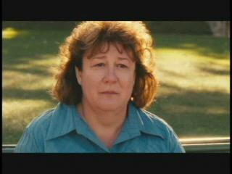
Using Exercices de style and Paris je t’aime to practice linguistic register
Watch the scene “14th arrondissement” from Paris je t’aime, and write a summary of it three times, using 3 of the styles that you have seen in Exercices de style
Notes:
This scene is also important for introducing the concept of the ‘other.’

Slide 34

Using Paris je t’aime for context to practice narration
In class, we watched the clip “Faubourg Saint Denis” from Paris je t’aime. In your composition, you will imagine and describe what happened after this scene. Use the guidelines provided to organize your writing.

Slide 35
I. Before writing
Point of view
Decide who is going to tell the story:
one of the characters from the scene (Francine or Thomas)?
someone else?
Perspective
Decide which emotions will dominate: regret? bitterness? relief? hope? interest?
Metaphors?
Can you think of any metaphors to integrate into the story?
Theme
What lesson do you want to share with your reader? What will they learn? What is the theme of your composition?
Title
Make sure to come up with a creative title for your story.

Slide 36
II. Organization
Remember what we have learned about narratives in the chapter from Katz and Blyth.
Prince:
events must have clearly defined beginnings and ends, and they must be non-trivial, specific, and relevant to humans;
there must be conflict between two opposites or adversaries;
there must be a discernible beginning, a middle, and an end;
the audience must recognize the text as a narrative. (Prince 1982, 1991)
Fleischman:
Abstract: what will this be about?
Orientation: who, what, when, where?
Complicating Action: what happened?
Narrator Evaluation of Events: so what?
Resolution: what finally happened?
Coda: what is the relation to the present context?

Slide 37
Format
1. An introductory sentence to attract the interest of of your reader: What’s it about? Why should we be interested in reading it?
2. The scene: Where did it take place? When?
3. The plot: What happened?
4. Evaluation of the narrator: How does the narrator feel about what is going on?
5. Dénouement/result: What is the relationship with the present? What has one learned?
NOTE: BE SURE TO WRITE IN THE PAST

Slide 38
Other possible assignments/activities:
A compte rendu (a review of a movie or a book)
A letter to the editor
A newspaper article
A transcription of spoken French
Presentation of a song (with a Parisian perspective) – analysis of language (register, etc.)
Final paper: an analytical paper that discusses the main themes of the course

Slide 39
How are these courses different from typical 3rd or 4th year language courses?
Genre-based: Language and culture are intertwined through textual models
Students work as researchers through sequences of scaffolded analysis of texts
Linguistically focused, but at the discourse level
Grammar is taught as discourse, not in the usual grammar review format

Slide 40
Discussion questions
Is the “bridge” metaphor really the most appropriate one to capture what needs to be accomplished to integrate language and content in the undergraduate FL curriculum? If not, should we come up with something else?
What types of objectives should bridge courses include to build students’ confidence and motivation and encourage them to continue “over the bridge”?
How do we promote better collaboration between language and literature faculty? Can efforts to integrative language and content be expanded beyond bridge courses? How?

