Slide 1
We Hear You: Successful Strategies for Marketing, Implementing and Analyzing a LibQUAL Survey

Slide 2
Presented by: Ashley Dupuy Rita Spisak Chris Sharpe Sponsored by the Public Relations Committee of GLA

Slide 3
What is LibQUAL?
Tested on-line survey instrument
Association of Research Libraries
Started in 1999, Texas A&M Libraries
1,000 libraries, 1MM people

Slide 4
Quantitative Results: What does it measure?
Service quality on three dimensions
Library as Place
Affect of Service
Information Control

Slide 5
How does it work?
3 areas, 9-point scale
Minimum Level of Service
Desired Level of Service
Perceived Level of Service

Slide 6
Example

Slide 7
Response Rate
5,253 valid surveys (approximately 22.4%)
1,856 comments
Largest number of valid survey responses of any school in the U.S….EVER.

Slide 8
Implementation
Project Manager
Committee
Timeline/schedule
LibQUAL admin
IRB
Other University departments
Prizes

Slide 9
FAQs

Slide 10
Results
Library website
Highlights brochure
Selected comments
Congratulate winners
PowerPoints for presentations

Slide 11
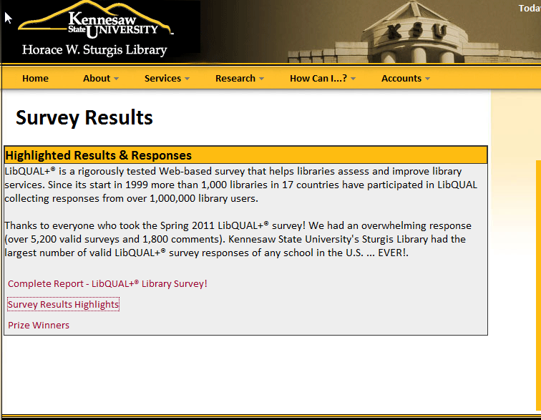
Results
www.kennesaw.edu/library/surveyresults

Slide 12
Marketing
Three Subcommittees
Graphics/Copy – 4 members
Marketing Implementation/Budget –
3 members
Qualitative analysis – 2 members

Slide 13
Marketing
Graphics/ Copy Committee
Create Print Marketing Materials
Flyers, posters, table tents, bookmarks, buttons
Ads –newspaper, website, KSU digital sign
Kickoff materials
Copy for all print materials, ads, emails

Slide 14
Marketing
Why Re-Invent the Wheel?
Looked at LibQual Marketing Website
Needed professional design
Short emails
Our Design
One theme – Win a Free iPad
Simple – can be used vertically and horizontally
Use student assistants as models

Slide 15
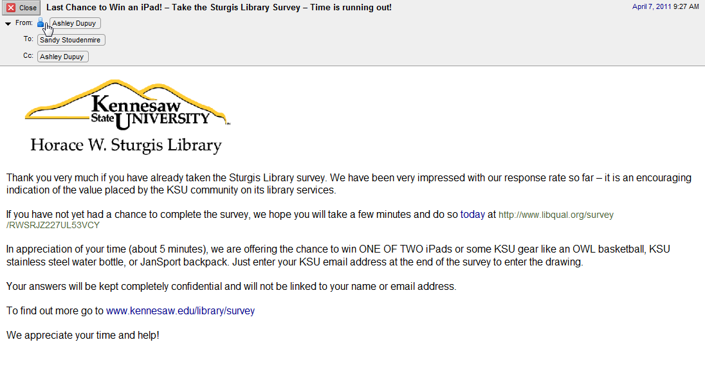
Sample Email

Slide 16
Marketing
Why Re-Invent the Wheel?
Looked at LibQual Marketing Website
Needed professional design
Short emails
Our Design
One theme – Win a Free iPad
Simple – can be used vertically and horizontally
Use student assistants as models

Slide 17
Marketing

Slide 18
Marketing
Marketing Implementation/ Budget Committee
Purchased Items
Printed flyers, bookmarks, table tents, posters
Button pins and backs
Fifty - 5” by 7” clear frames for table tents from Walmart
Ads for the school newspaper
Banner for Student Center

Slide 19
Marketing
Marketing Implementation/ Budget Committee
Free Items—Examples
Kickoff event with mini-cupcakes
Book Store donated 8 KSU logo prizes
PSA KSU Owl Radio
Campus-wide digital signs
Newsletters on campus
Announcement on GeorigaVIEW Vista
Wallpaper ad and pop up on library website
Emails to students, faculty, and staff
Library Public Service Staff promoting verbally and wearing buttons
Promoting survey with laptops in lobby first and last weeks

Slide 20
Qualitative Results
Why review qualitative results?
LibQUAL does not provide qualitative analysis
Analysis would provide more detailed information
1,856 = total comments 3,135 = discrete statements
Some wrote essays!
**large number of comments** (in 2006 UGA had 582 comments)

Slide 21
Qualitative Process
Read other universities’ analyses
Identified basic codes/keywords
Copiers/printers- negative
Library building-aesthetics-negative
Library--general—positive
Added codes/keywords as necessary
Used software (Concordance 3)
Cheryl and Chris read & analyzed every comment and collated the information
Comments were in Word document

Slide 22
Concordance 3
Software for text analysis
Make indexes, word lists
Count word frequencies
Find phrases
http://www.concordancesoftware.co.uk/
30-day free trial for personal
evaluation only
$87

Slide 23
Concordance 3
Screenshot from http://www.concordancesoftware.co.uk/

Slide 24
Sample of Comments & Notes

Slide 25
Qualitative Results

Slide 26
Qualitative Results
Negative = 1,869
Positive = 1,048
Neutral/suggestions = 218
Total = 3,135 (Discrete Statements)

Slide 27
Top Ten Positive Comments
Library-General (364)
Employee Positive (179)
Customer Services (128)
Thank you (51)
Love the Library (45)
6. Database access (35)
7. ILL (30)
8. Cubicles (19)
GALILEO (19)
GIL-Express (17) & Individual Staff (17)

Slide 28
Top Ten Negative Comments
10. Do not use or no longer use library because…(47)
9. Library hours—need to increase (50)
8. Copiers, printers, Kcash machine not working, not enough support (83)
7. Furniture—need better, more comfortable, more modern, etc (90)
6. Study space—need more for individual (109)
5. Noise—too loud, need for enforcement of noise policy (112)
4. Study space—need more for group work (165)
3. Book collection in print—need much larger and more up to date (167)
2. Computers—need more PCs and laptops, need better tech support/updates, need Macs, and need scanners (251)
1. Library Building (362)

Slide 29
Examples of Comments
Compliment: “The Library has several shining stars on the staff who are everything you would want - helpful, courteous, conscientious and knowledgeable, with a love for books and learning…” 1700-S
Criticism: “I simply don't go to the library because it is [grim], uninviting and extremely uncomfortable…The computers in there are awful too. Slow, old and dirty...” 1756-U
Suggestion: “Facebook should be blocked in the library.” 1568-U
Collection Suggestion: “I would like to see more recent materials on conflict resolution, peace, social movements, and social justice.” 40-S

Slide 30
Examples of Funny Comments
“When I come in the library I am reminded of a line from an old song, ‘Its dark as a dungeon way down in the mine.’ That's about how appealing the library is as a place.” 1118-U
“I enjoy the library staff.” 1299-U
“Grown men who always complain they are hot say it is freezing in here.” 1182-G
“I have heard horror stories about people loudly eating fried chicken…” 652-U
“Finding a book among 50,000 in the library seems like an ancient way to get information. If I was studying history or something of the sort I might have a need for the library but... there's nothing much there that attracts me.” 512-U
“As for the building, welcome to the 1970s! If you like to time travel to the past it is fine. If you actually want quiet, open, well-lighted space conducive to research and study, f--o--r--g--e--t about it.” 715-U

Slide 31
Questions? or Comments

