Slide 1
“Give The Patrons What They Want: Even If You Don’t Have It Yet!”
A patron-driven acquisition collaboration between interlibrary loan and collection development at Kennesaw State University
Ana Guimaraes
Collection Development Librarian
aguimar1@kennesaw.edu
Ashley Hoffman
Interlibrary Loan Paraprofessional
ahoffm18@kennesaw.edu

Slide 2
PDA and ILL at Sturgis Library
Why Now?
Research
The Plan
Application
Outcome
What next?
Why Now?
Research
The Plan
Application
Outcome
What Next?

Slide 3

Why Now?
Why Now?
Research
The Plan
Application
Outcome
What next?
Good timing
eBook demand-driven acquisition (DDA) program already in development
Expanding interlibrary loan services: document delivery
campaign: transforming services and collection
Increased interest in collection development

Slide 4
Research
Why Now?
Research
The Plan
Application
Outcome
What next?
Literature review to weigh PROS and CONS
Lack of cost-per-use data
Stakeholders:
  - Internal (CD, ILL, acquisitions, access services)
  vs.
  - External (patrons, vendors, consortia partners)

Slide 5
Research
Why Now?
Research
The Plan
Application
Outcome
What next?
“The ACRL (2010) listed PDA as a new force in collection development explaining: ‘academic library collection growth is driven by patron demand and will include new resource types’.”
(Wiley, 2012, p.105)
Factors contributing to PDA:
  Low circulation
  Economic recession
  and budget cuts
  Availability of new vendor products for online ordering

Slide 6
Research
Why Now?
Research
The Plan
Application
Outcome
What next?
Literature review to weigh PROS and CONS
Lack of cost-per-use data
Stakeholders:
  - Internal (CD, ILL, acquisitions, access services)
  vs.
  - External (patrons, vendors, consortia partners)

Slide 7
Research
Why Now?
Research
The Plan
Application
Outcome
What next?
ILL, Patrons, and Subject Liaisons:
  Underrepresented subjects and departments
  Tracking curriculum changes
  New or developing program areas
“ILL increases the connection between academic departments and the library, and can help identify areas where the library needs to improve while highlighting current users.”
(Leykam, 2008, p.219)

Slide 8
Research
Why Now?
Research
The Plan
Application
Outcome
What next?
Literature review to weigh PROS and CONS
Lack of cost-per-use data
Stakeholders:
  - Internal (CD, ILL, acquisitions, access services)
  vs.
  - External (patrons, vendors, consortia partners)

Slide 9
The Plan
Why Now?
Research
The Plan
Application
Outcome
What next?
Hypothesis: To improve customer service and library collections
Our mission and goals
Dates: June-July 2013
Parameter development and revision

Slide 10
The Plan
Why Now?
Research
The Plan
Application
Outcome
What next?
Scope
Only books…
  …that we don’t have
  ……..that we have to pay to borrow
  ……………that are available for rush purchasing
  ……………….that cost less than our $200 price limit

Slide 11
The Plan
Why Now?
Research
The Plan
Application
Outcome
What next?
Criteria
Must meet 2 out of 3 of the following:
  Requested by special status patron
  Requested at least once before
  Has a cost of less than $50

Slide 12
Application
Why Now?
Research
The Plan
Application
Outcome
What next?
Check Criteria
Place Order
Finish Processing
Add to collection
Patron Returns
Basic Processing

Slide 13
Outcome
Why Now?
Research
The Plan
Application
Outcome
What next?
 | Books to Be Purchased | Total Cost Before Shipping | Highest Cost to Borrow
June | 4 | $100.85 | $140.00
July | 9 | $264.70 | $315.00
Low numbers led to revision of parameters
Purchase cost less than highest cost to borrow
Time-consuming process
Problems encountered

Slide 14
Problems with Rush Availability
Why Now?
Research
The Plan
Application
Outcome
What next?
Outcome

Slide 15
Outcome
Why Now?
Research
The Plan
Application
Outcome
What next?
Key
“Popular” includes self-help, non-literary fiction, and popular non-fiction
“Rare” are books that were too rare to be found in our vendor’s catalog
“General Academic” was everything else
Types of Books Considered

Slide 16
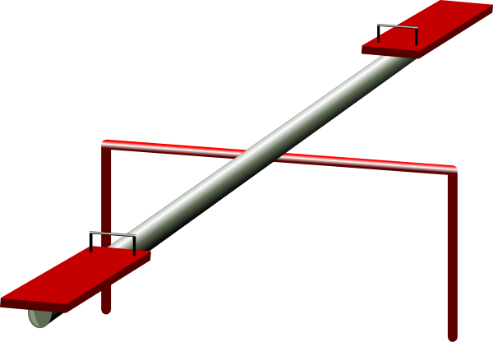
Outcome
Why Now?
Research
The Plan
Application
Outcome
What next?
Collection Development
Interlibrary Loan
ILL vs. collection development
Lessons learned

Slide 17
What Next?
Why Now?
Research
The Plan
Application
Outcome
What next?
Alternative vendors
Funding source
Borrow now, buy later
Use ILL statistics to inform subject liaisons
Revision of parameters to enhance collection development

Slide 18
Credits
Wiley, L. & Clarage, E. (2012). Building on success: evolving local and consortium purchase-on-demand programs. Interlending & Document Supply, 40(2), 105-110.
Leykam, A. (2008). Exploring interlibrary loan usage patterns and liaison activities. Interlending & Document Supply, 36(4), 218-224.
van Dyk, G. (2011). Interlibrary loan purchase-on-demand: a misleading literature. Library Collections, Acquisitions, & Technical Services, 35, 83-89.
Special Thanks:
Kiara Bynum, Interlibrary Loan Paraprofessional, Kennesaw State University
Jay Nicolletta, Acquisitions Paraprofessional, Kennesaw State University

Slide 19
Questions?
Thank You!

